Slide 1
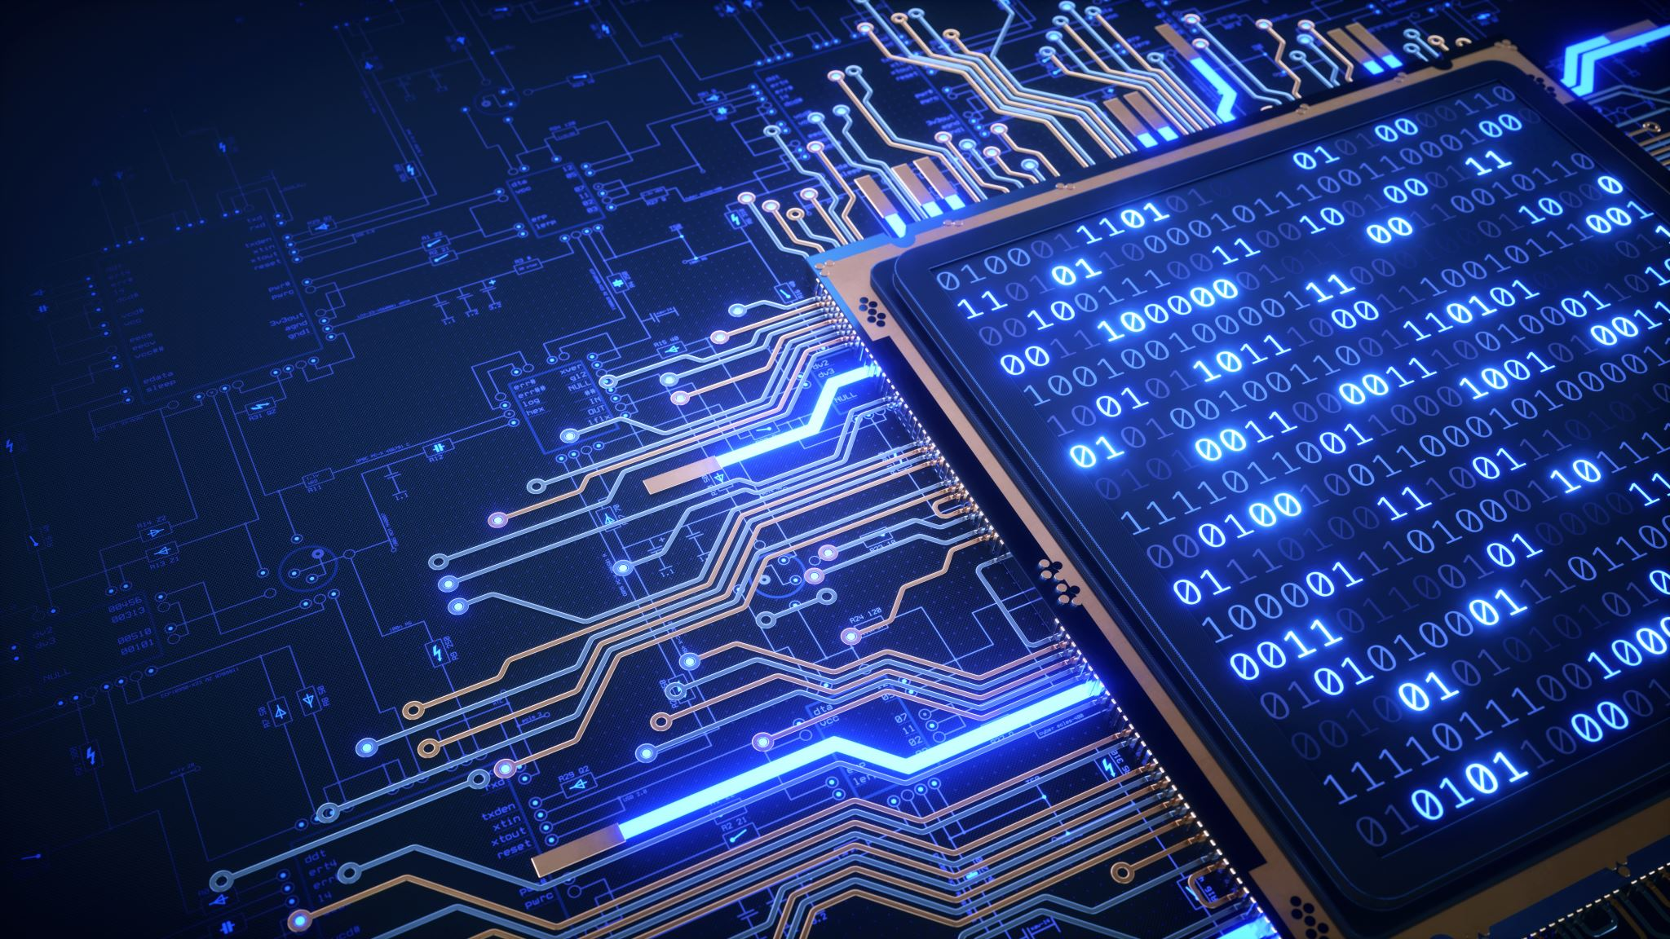
Software Solutions

Slide 2
AI is rapidly moving from a futuristic concept to a practical tool in healthcare, and its impact is set to accelerate significantly.
We are building
Solutions
that matter to you
"Tomorrow's" medicine will see AI deeply integrated into three core areas: diagnostics, treatment, and administration.

Slide 3

Tomorrow Medicine
AI is rapidly moving from a futuristic concept to a practical tool in healthcare, and its impact is set to accelerate significantly.
"Tomorrow's" medicine will see AI deeply integrated into three core areas: diagnostics, treatment, and administration.

Slide 4

Med-Tech Solutions

Slide 5
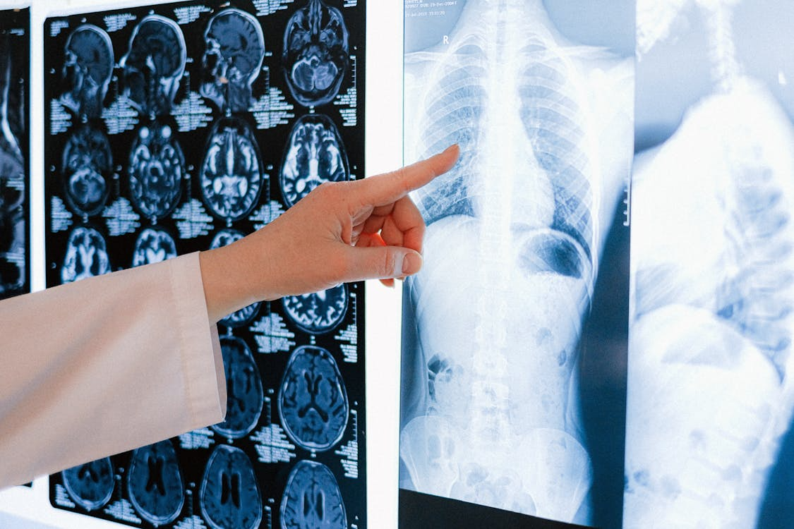
Slashing Timelines
The one-size-fits-all approach to medicine is ending. AI is the engine driving personalized medicine by:
60%
50% -70%
Tailoring Therapies
Accelerating Drug Discovery
Reduce documentation
Traditional drug discovery takes 10-15 years and costs an average of $2.6 billion per successful drug.
02
Hours Saved Daily
Tomorrow Medicine

Slide 6
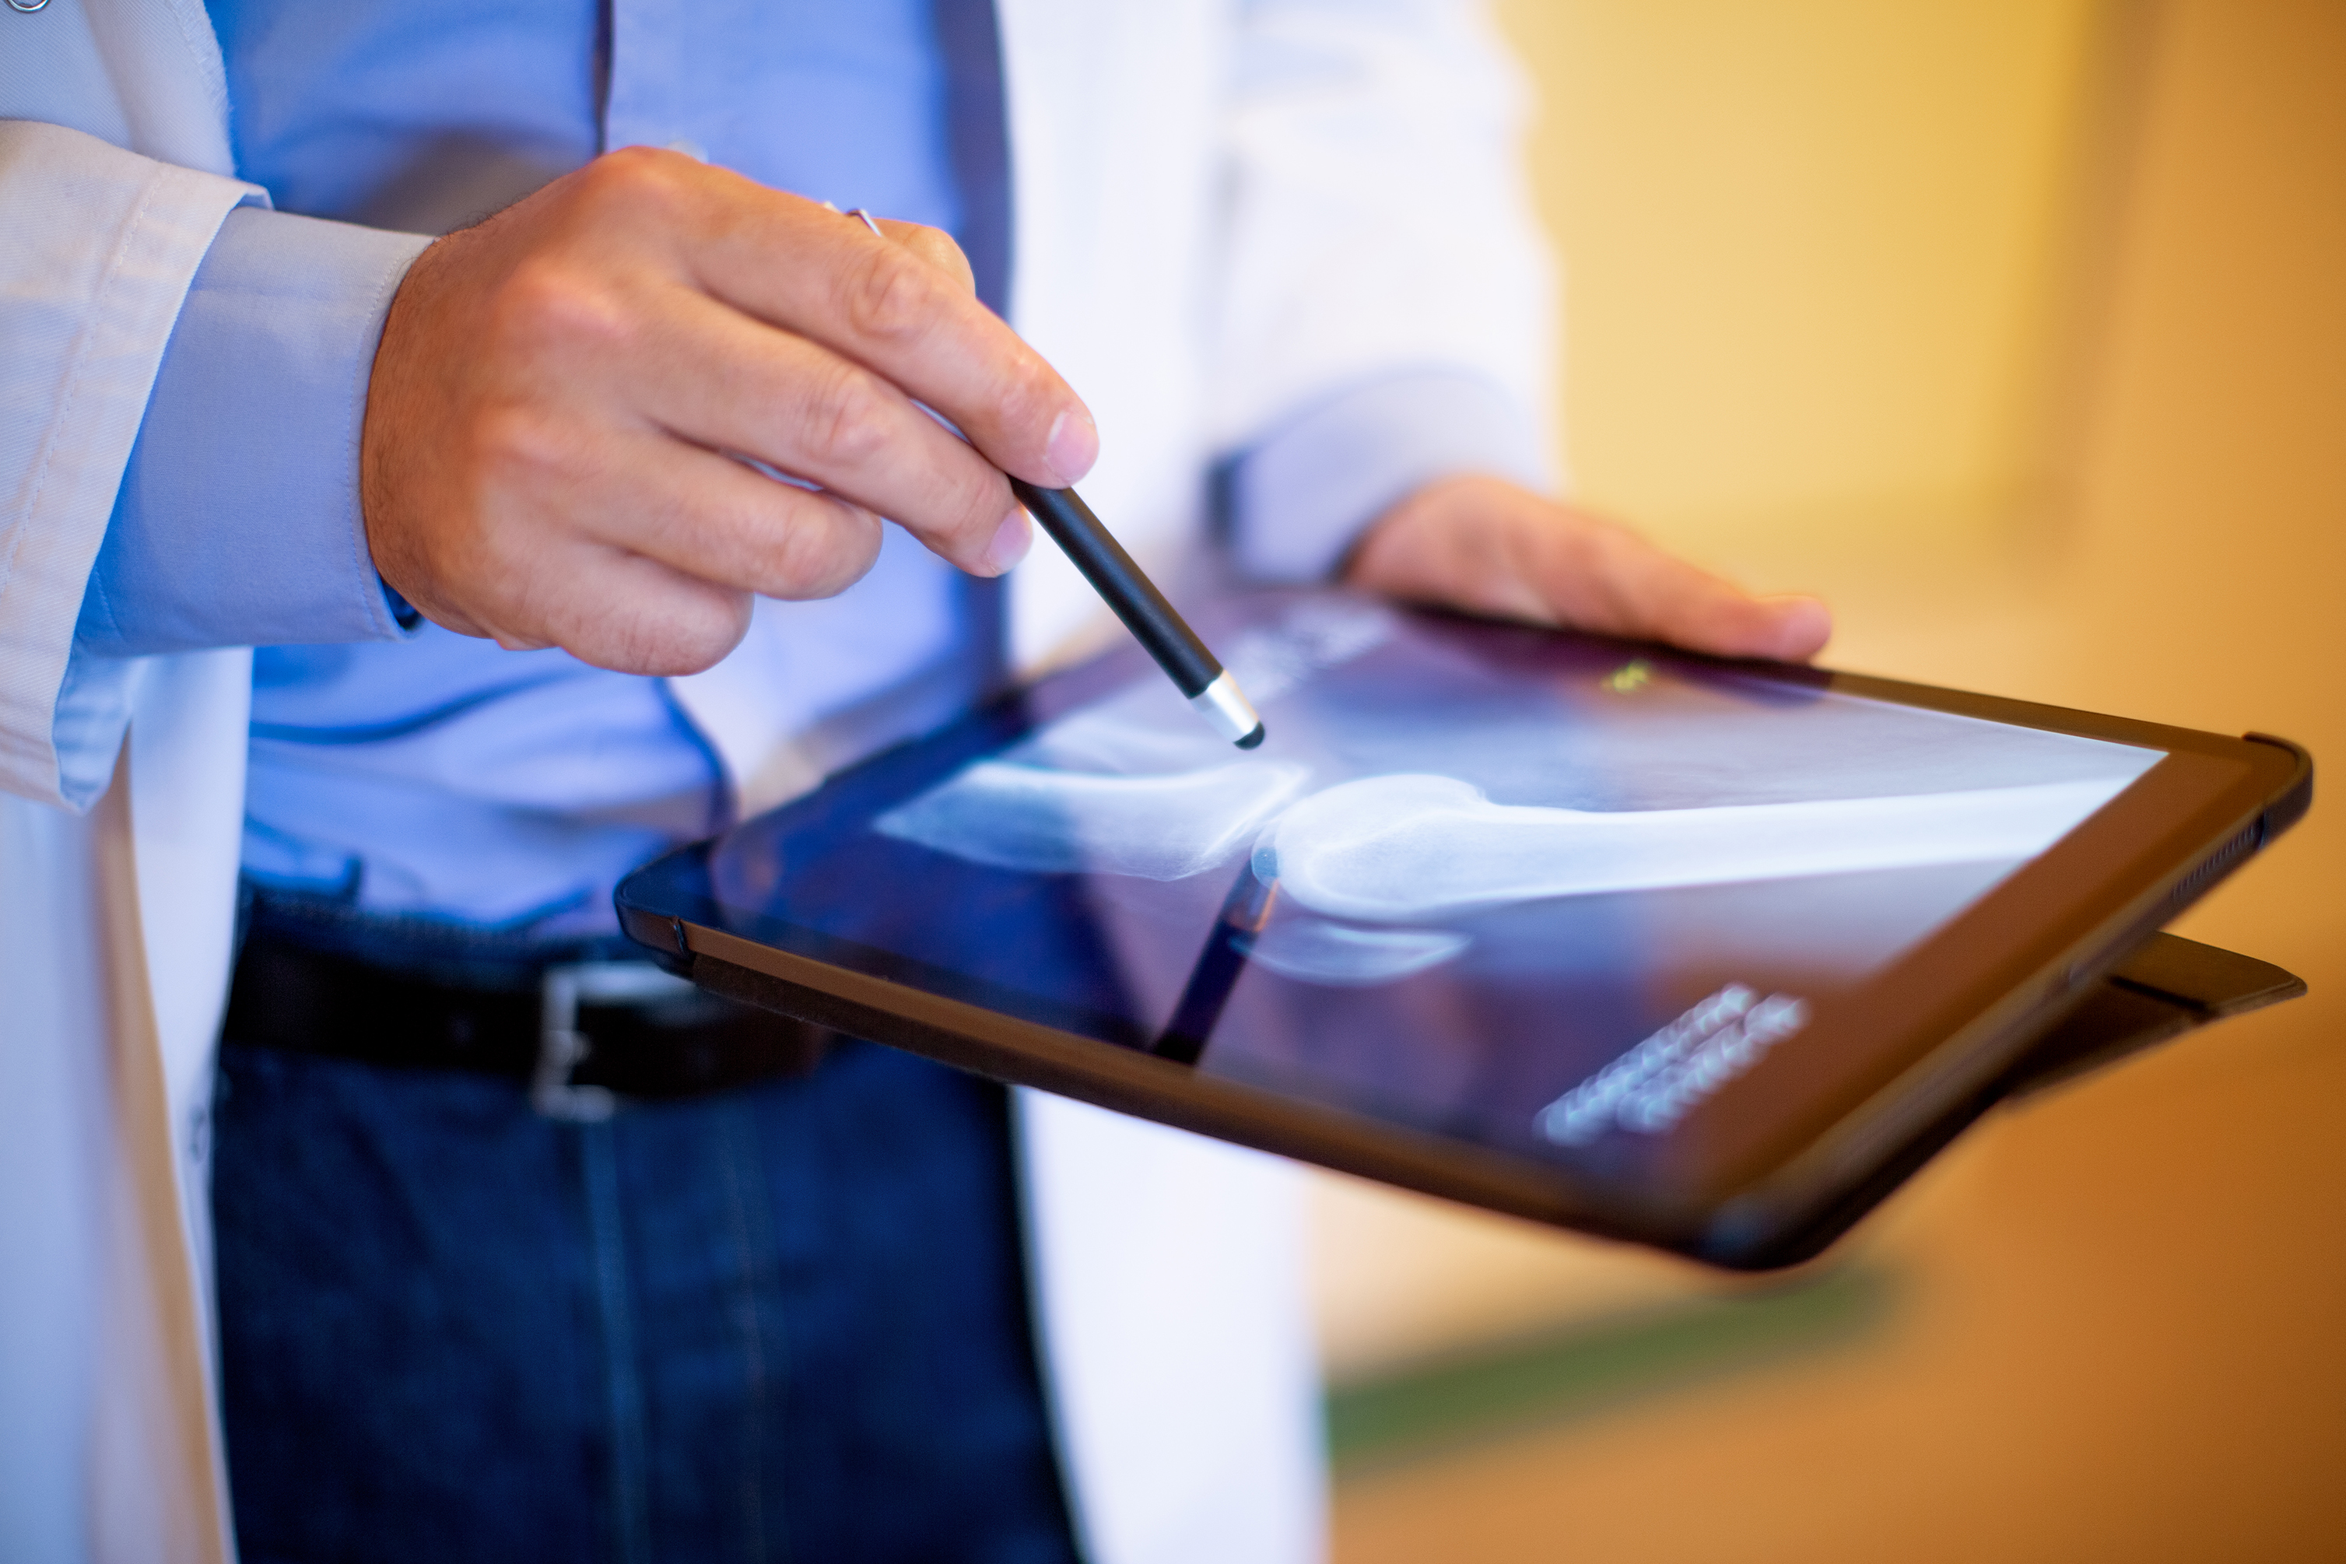
Tomorrow Medicine
AI is rapidly moving from a futuristic concept to a practical tool in healthcare, and its impact is set to accelerate significantly.
"Tomorrow's" medicine will see AI deeply integrated into three core areas: diagnostics, treatment, and administration.

Slide 7
Earlier Disease Detection: Spotting early-stage cancers, diabetic retinopathy, or neurological disorders far sooner than previously possible.
Increased Accuracy: In fields like pathology, AI can analyze tissue samples to help grade tumors, reducing human error and variability.
Speed: AI algorithms can analyze and flag urgent cases in a fraction of the time, helping to prioritize patients in busy emergency rooms.
60%
Reduce documentation
02
Hours Saved Daily
Tomorrow Medicine

Slide 8

Tomorrow Medicine
AI is rapidly moving from a futuristic concept to a practical tool in healthcare, and its impact is set to accelerate significantly.
"Tomorrow's" medicine will see AI deeply integrated into three core areas: diagnostics, treatment, and administration.

Slide 9
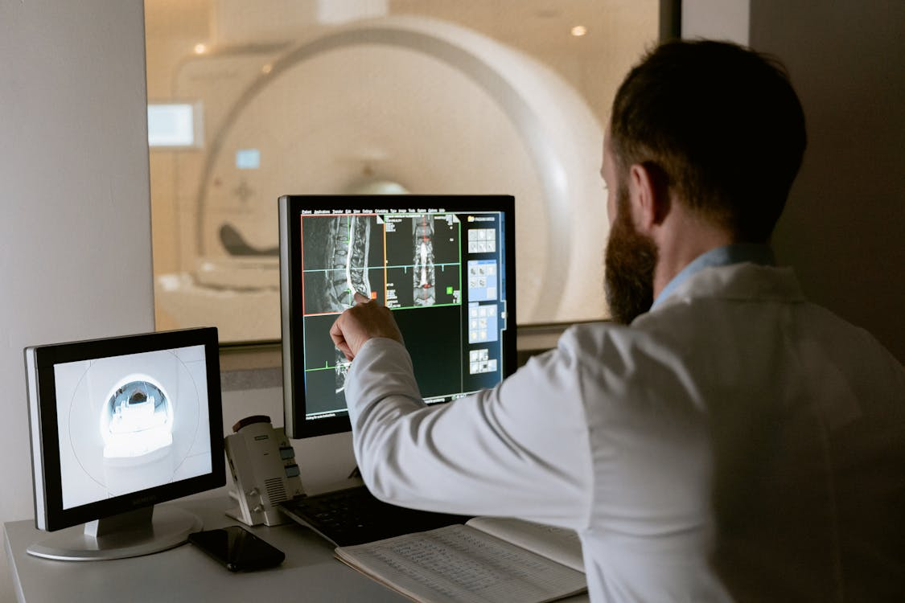
94%
90%
AI
Accelerates
Lung Cancer
Detection
Breast Cancer
Detection
AI is becoming a crucial partner for doctors, especially in analyzing medical images. Machine learning models, trained on millions of scans, can now detect subtle patterns in X-rays, CT scans, and MRIs that a human eye might miss.
Tomorrow Medicine

Slide 10
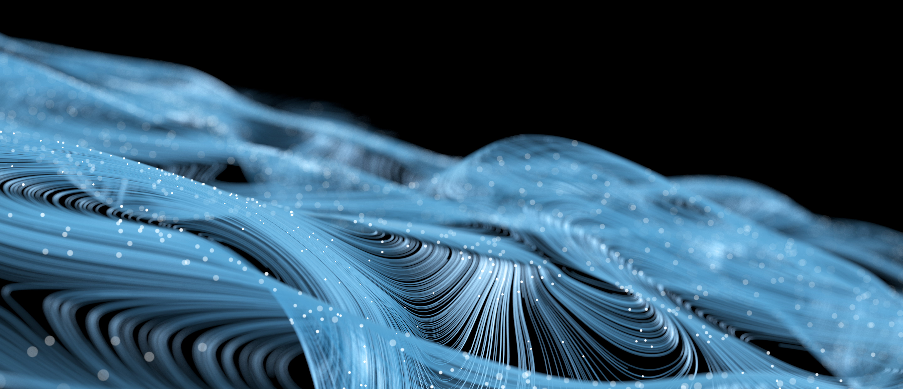
Thank You

